Slide 1
Preliminary calcium imaging analyses on spatial reversal task
Lab meeting
February 1, 2021

Slide 2
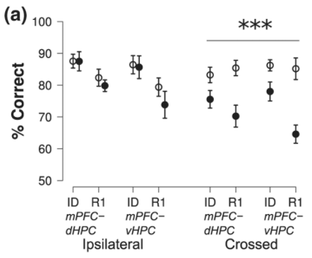

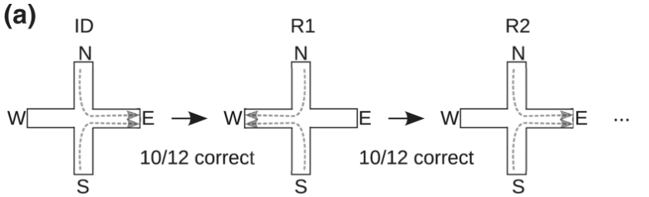
dCA1 and vCA1 projections to frontal cortex are necessary for spatial reversal
Avigan et al., 2020

Slide 3
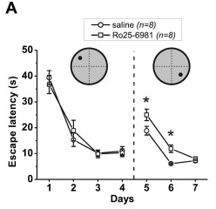
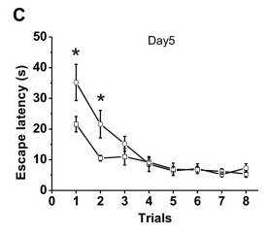
LTD inhibition in CA1 impairs spatial reversal
Elevated platform stress induces LTD and accelerates reversal learning
LTD inhibition impairs reversal learning
Dong et al., 2013

Slide 4
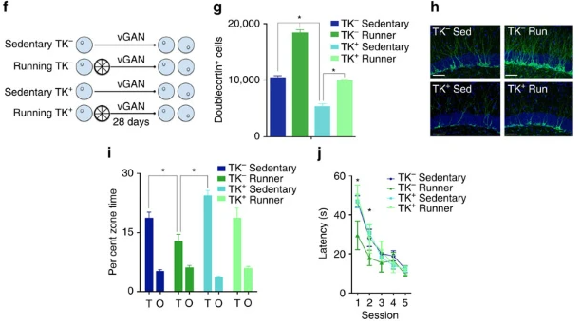
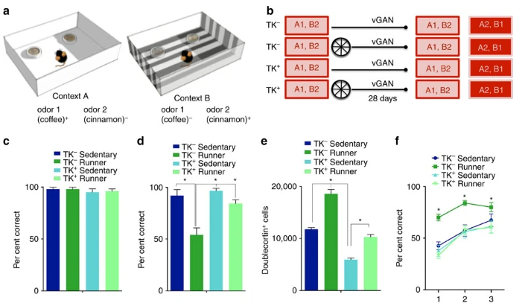
Neurogenesis is important for spatial reversal
Most neurogenesis
Most neurogenesis
Epp al., 2016

Slide 5
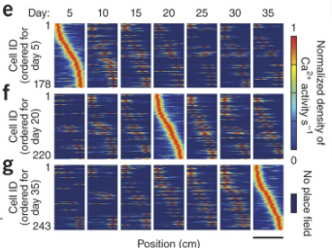
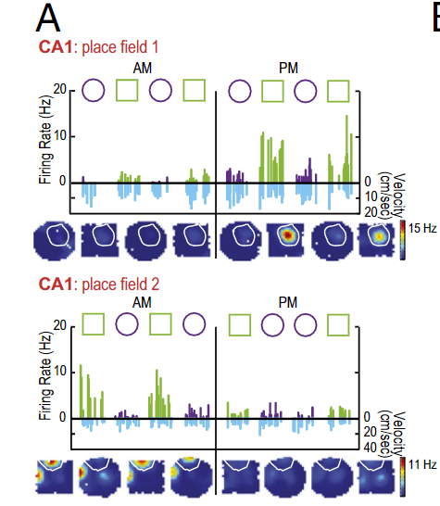
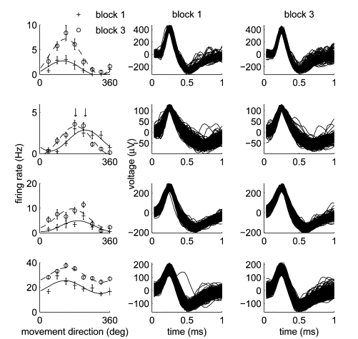
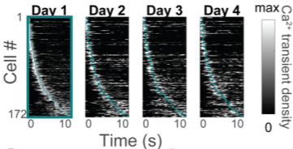
Neural correlates of memory are not completely stable – “drift”
Mankin et al., 2012; 2015
(rat CA1 and CA2, tetrodes)
Ziv et al., 2013; Mau et al., 2018 (mouse CA1, miniscopes)
Rokni et al., 2007 (monkey SMA and M1, monotrodes)

Slide 6
Hypothesis: Drift reflects (homeostatic?) plasticity that endows flexibility on neural networks
Reversal performance
“Persistence”

Slide 7
Hypothesis: Drift reflects (homeostatic?) plasticity that endows flexibility on neural networks
Reversal performance
Reversal performance
“Persistence”
“Persistence”
Control
Inhibiting plasticity
Control
Inhibiting plasticity

Slide 8
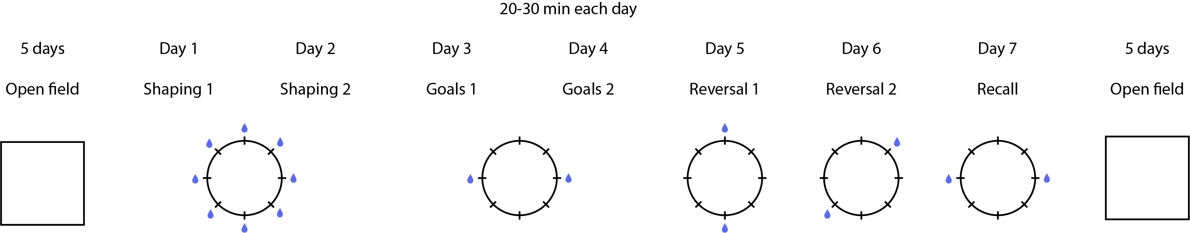
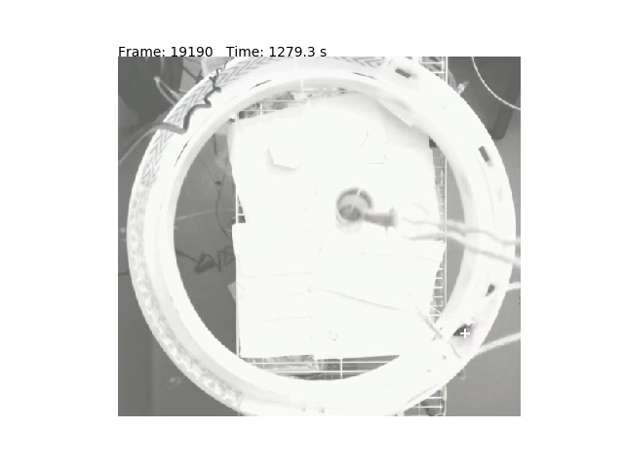
n = 5 wild-type adult mice
(+6 behavior-only mice):
Castor
Encedalus
Hydra
Fornax
Io
V3
Poor behavior due to tech difficulties
V4

Slide 9
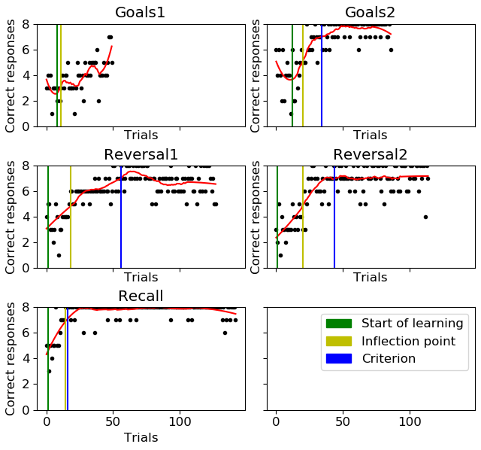
“Trials to criterion” for measuring reversal performance
Criterion arbitrarily defined as 5+ consecutive trials where smoothed correct responses ≥ 7

Slide 10
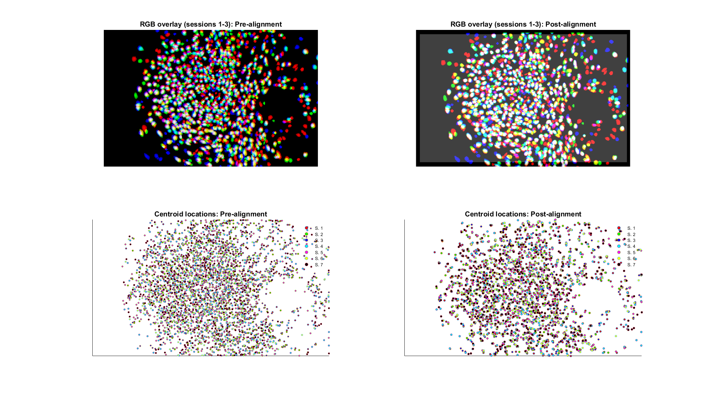
Castor, V3

Slide 11
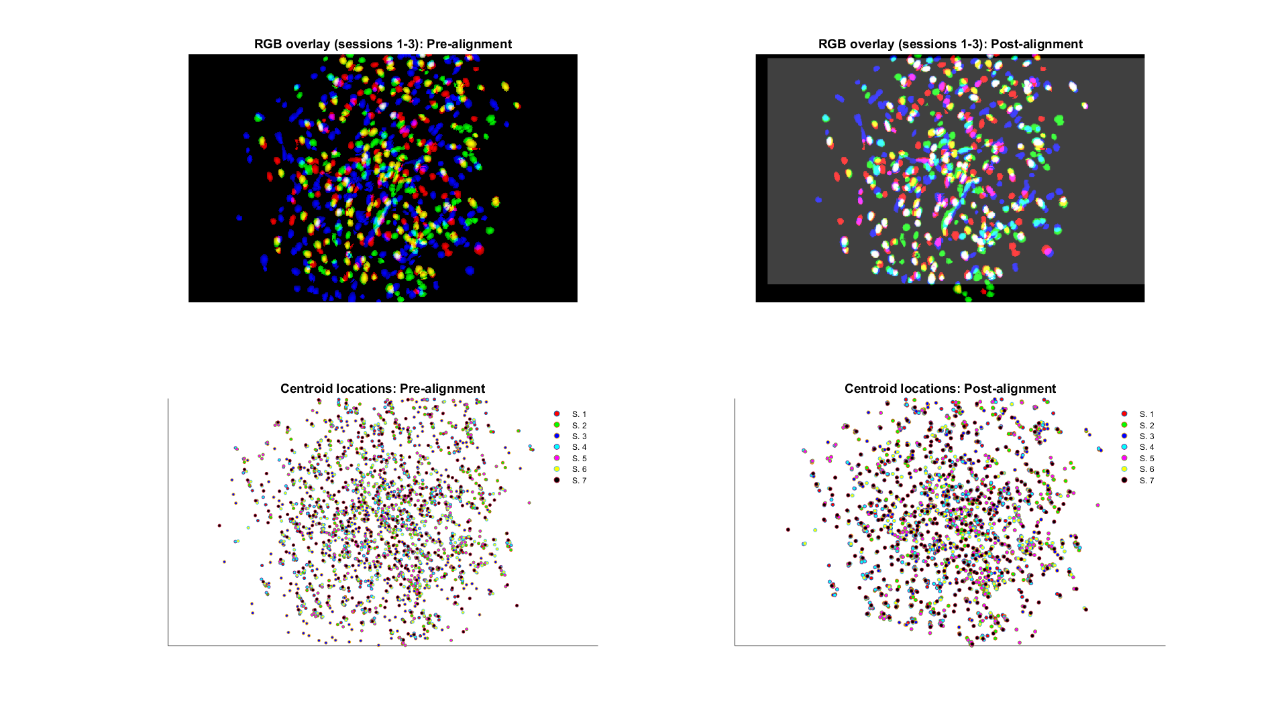
Encedalus, V3

Slide 12
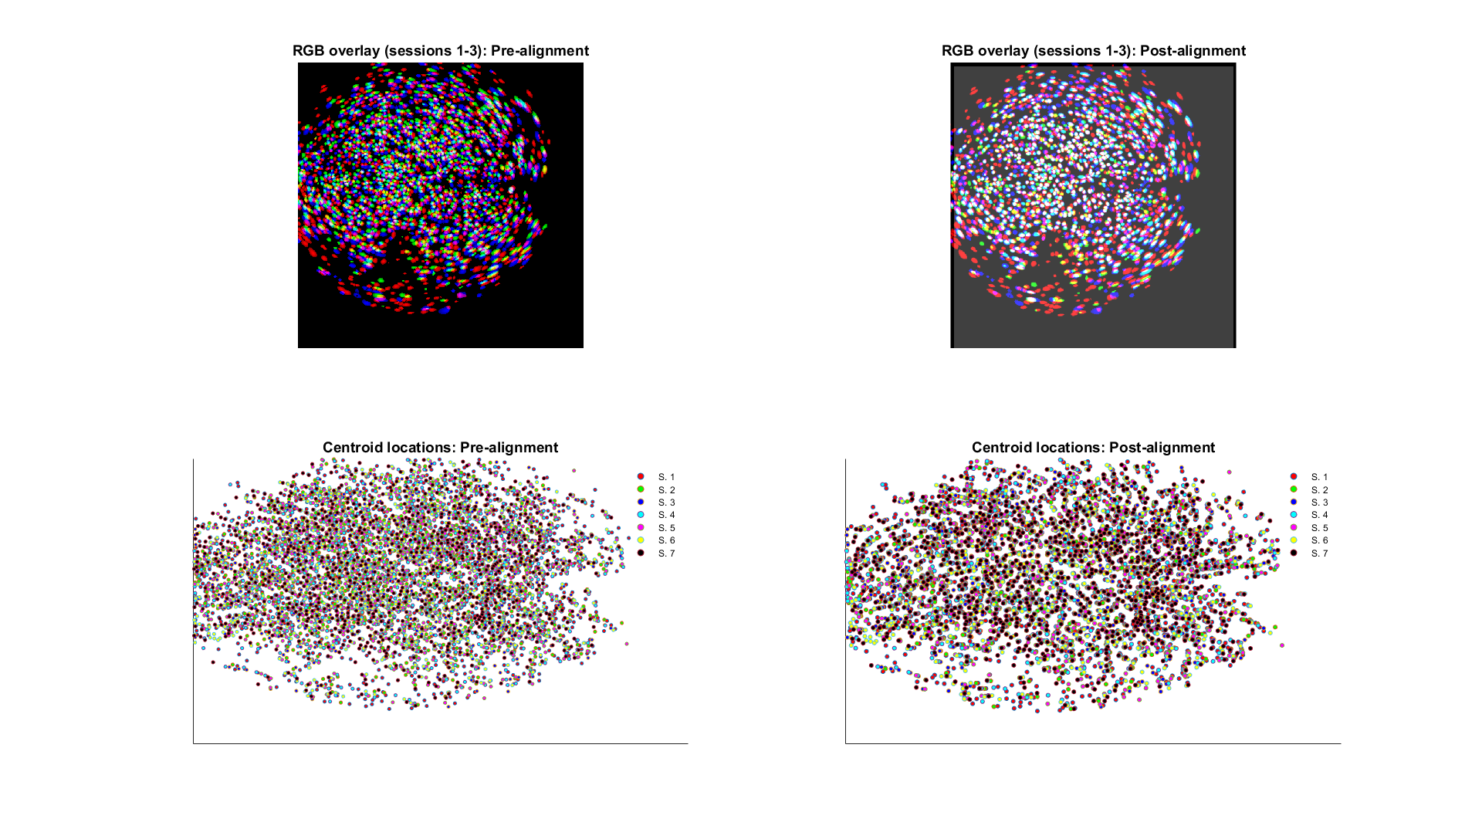
Fornax, V4

Slide 13
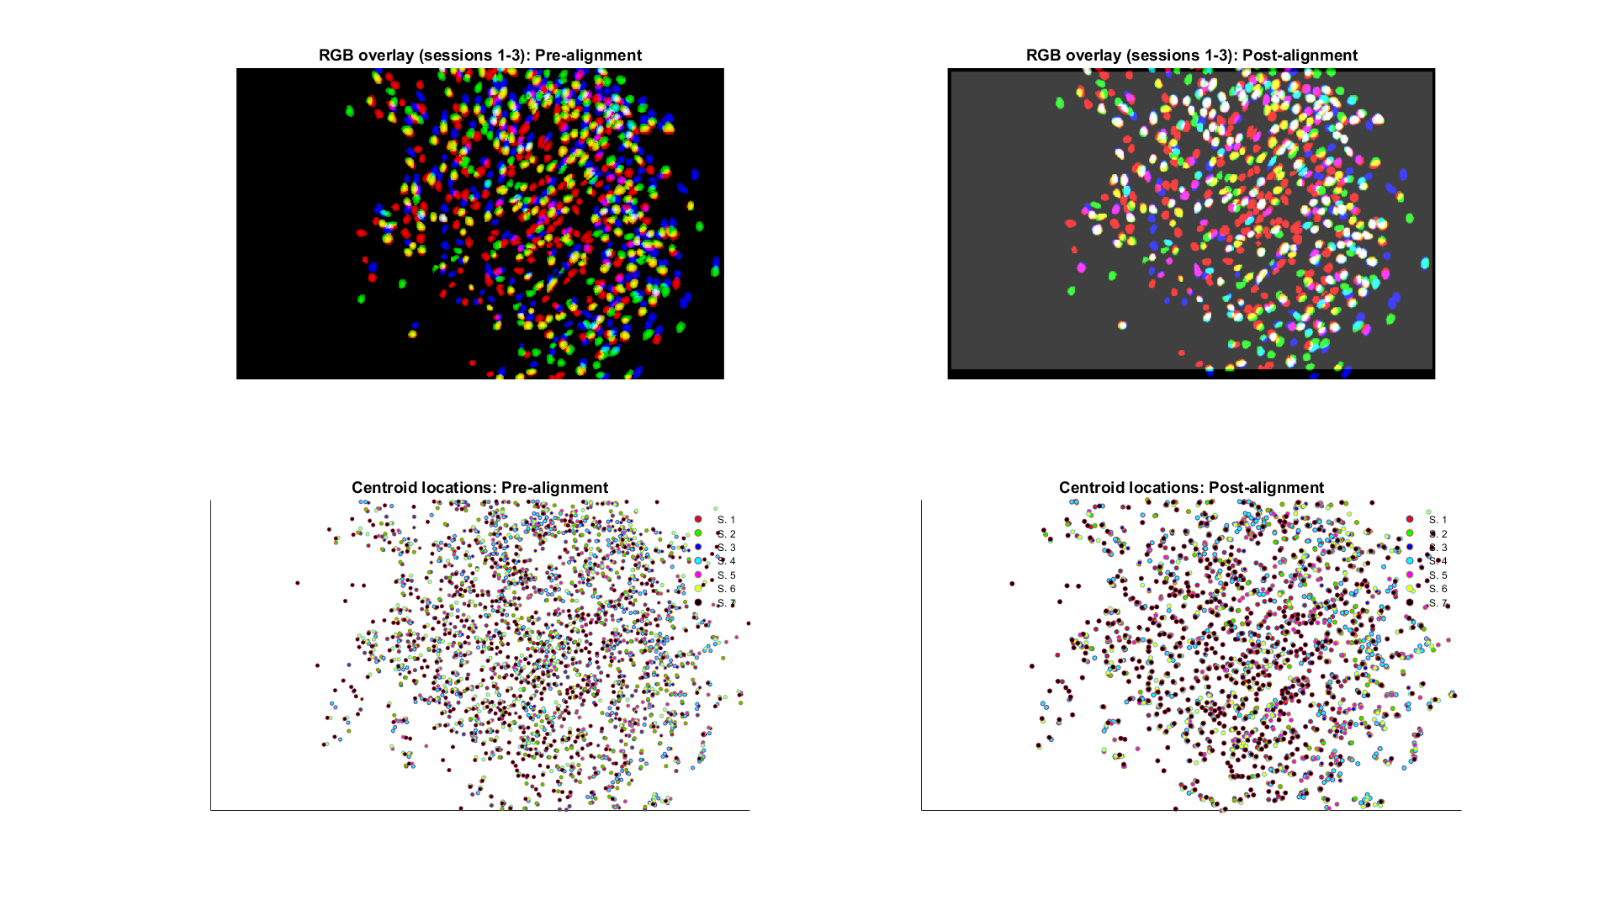
Hydra, V3

Slide 14
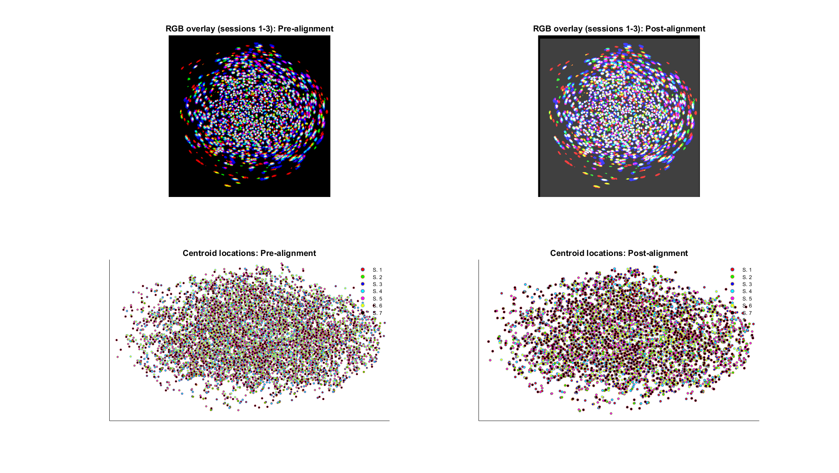
Io, V4

Slide 15
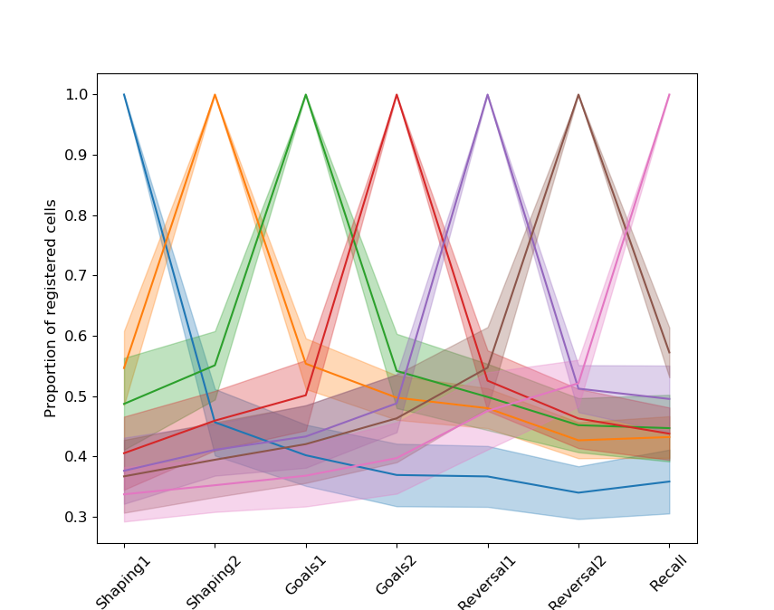
Cell registration overlaps

Slide 16
How to measure “persistence”?
Firing field correlations
Ensemble reactivations

Slide 17
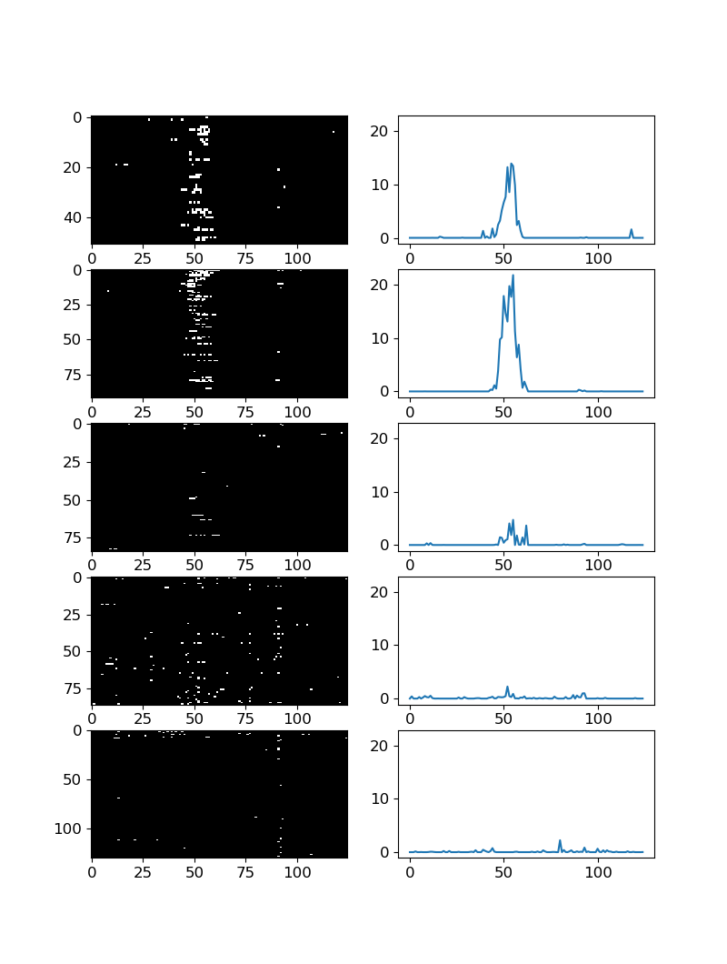
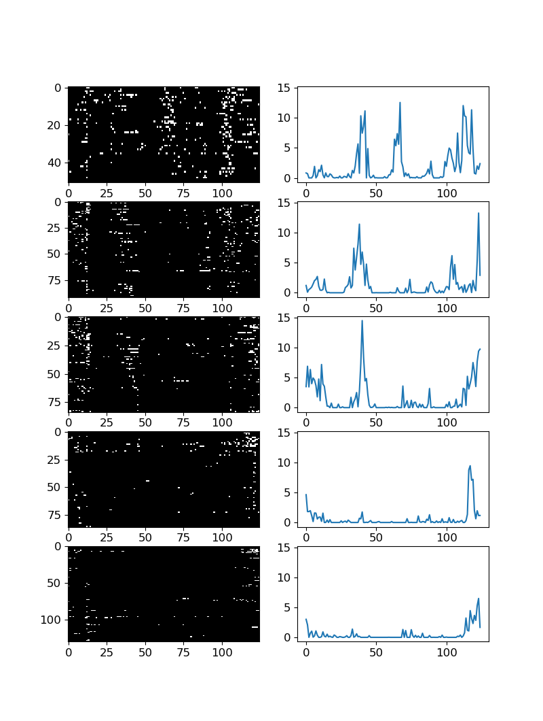
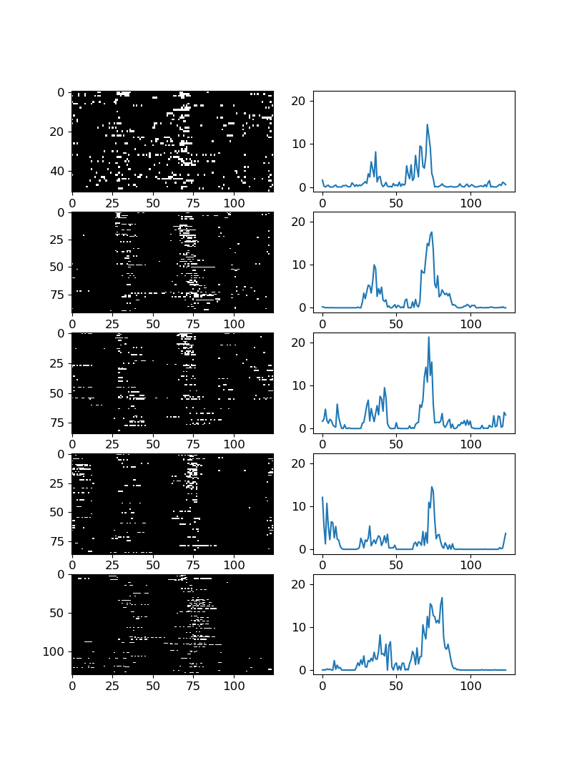
Visualizing classical place fields

Slide 18
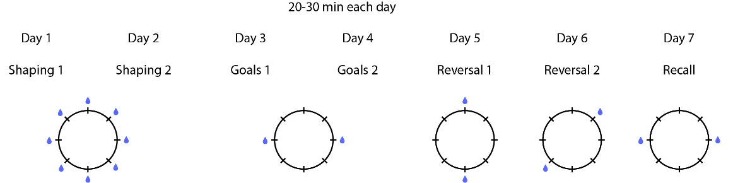
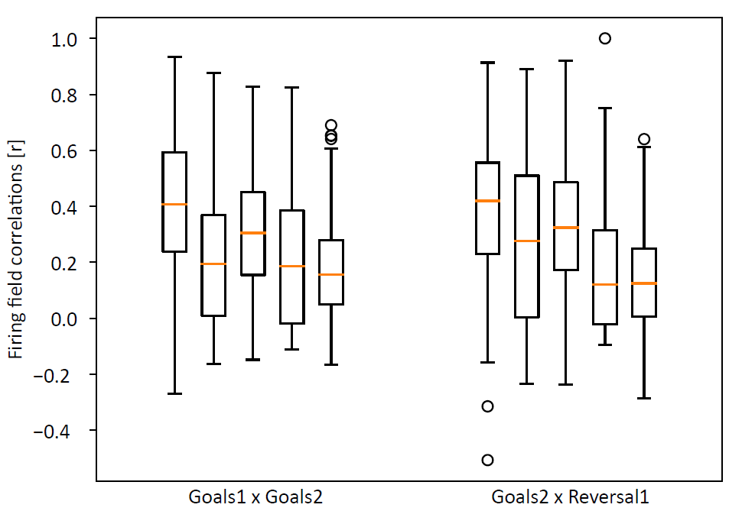
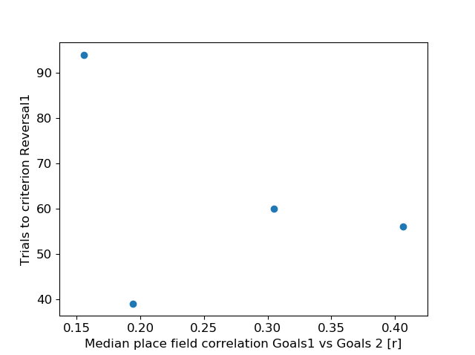
Does stability anti-correlate with flexibility?
Correlate fields
Assess performance

Slide 19
How to measure “persistence”?
Firing field correlations
Ensemble reactivations

Slide 20
PCA/ICA procedure for detecting ensembles
Activity (S) is binarized, binned, and normalized.
Determine # of ensembles by comparing PCA eigenvalues to those from shuffled data (independent cell-by-cell circular shifts).
Extract weights of cells towards each ensemble with ICA where # of components = # of ensembles
Estimate ensemble activity (co-activation of highly-weighted cells).

Slide 21
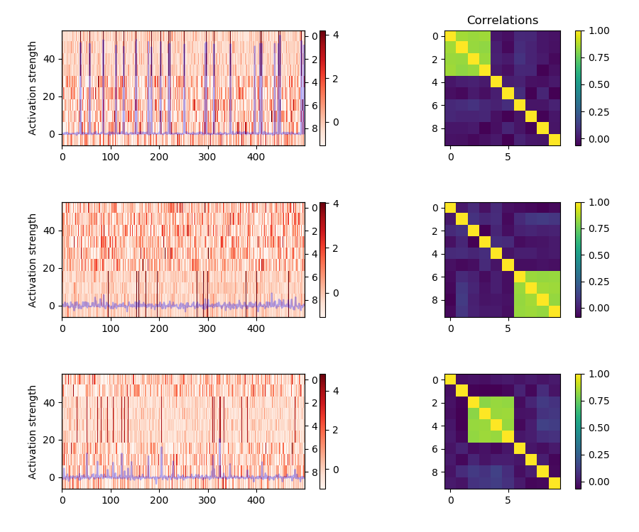
Assembly detection using PCA/ICA

Slide 22
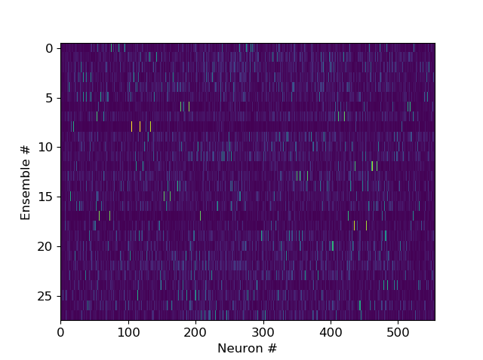
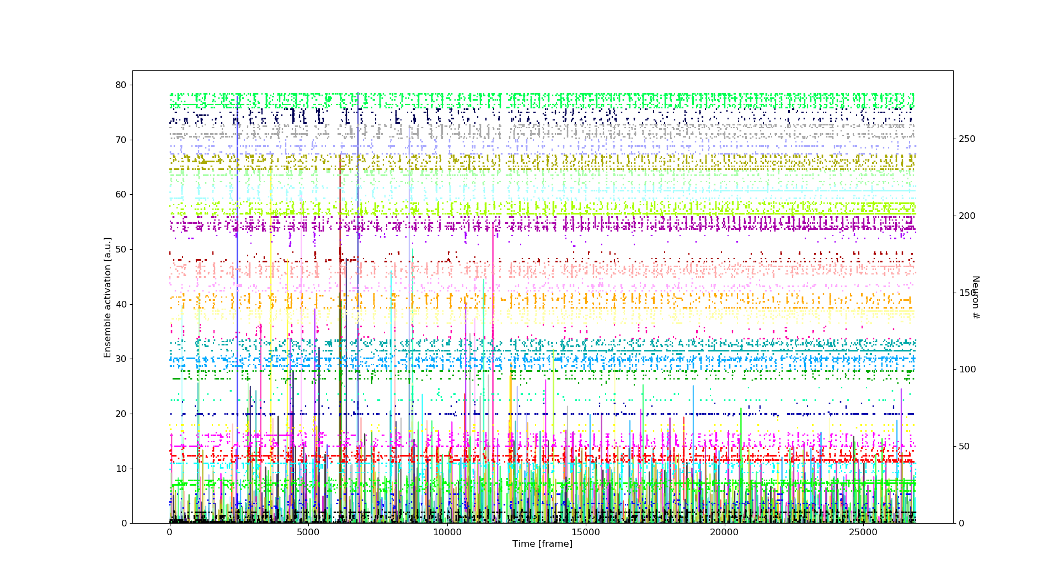
PCA/ICA outputs on real data (Castor, Goals2)

Slide 23
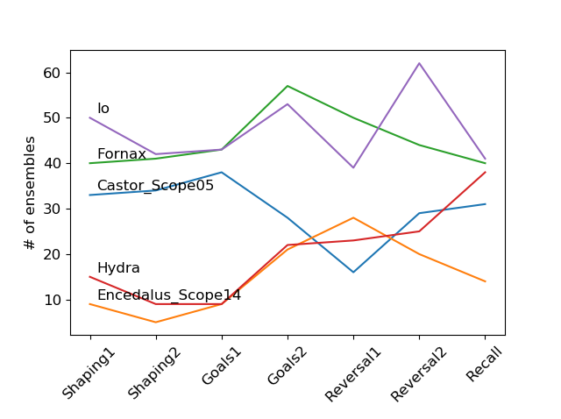
# of ensembles mostly constant across sessions

Slide 24
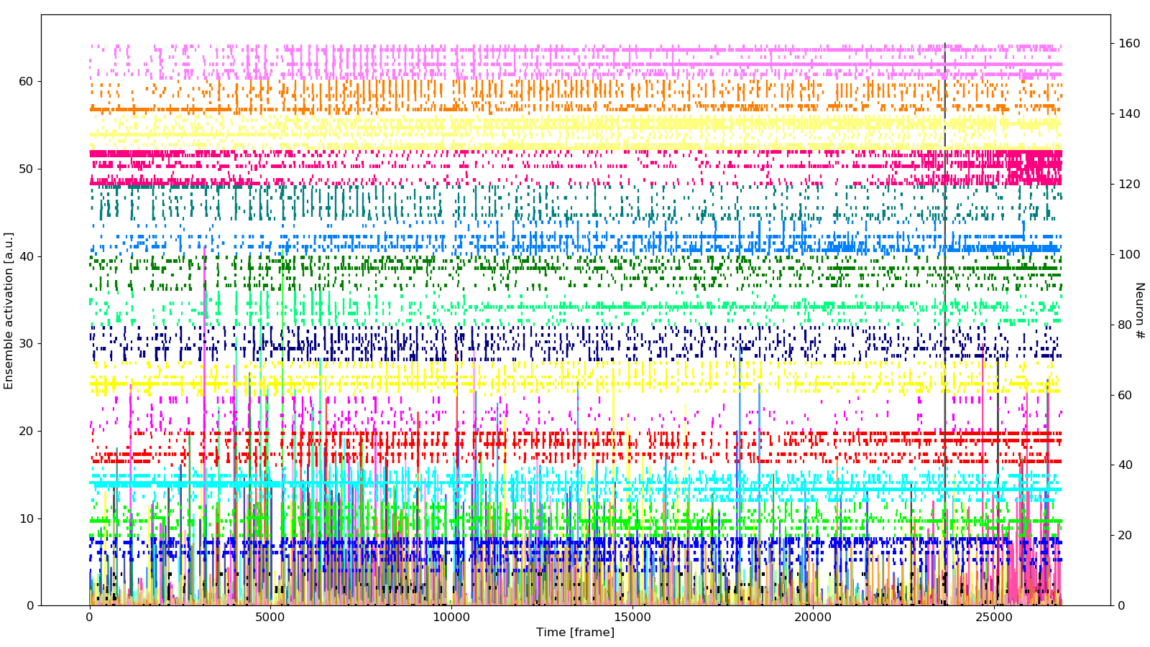
Comparing ensemble activations in Reversal vs. Goals sessions
Goals2
Reversal1

Slide 25
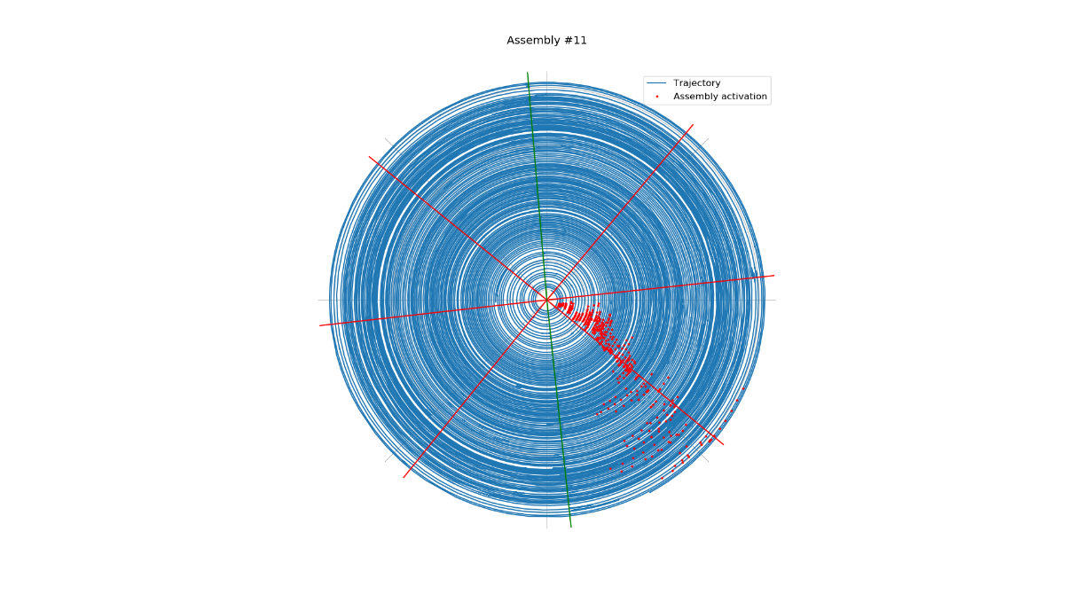
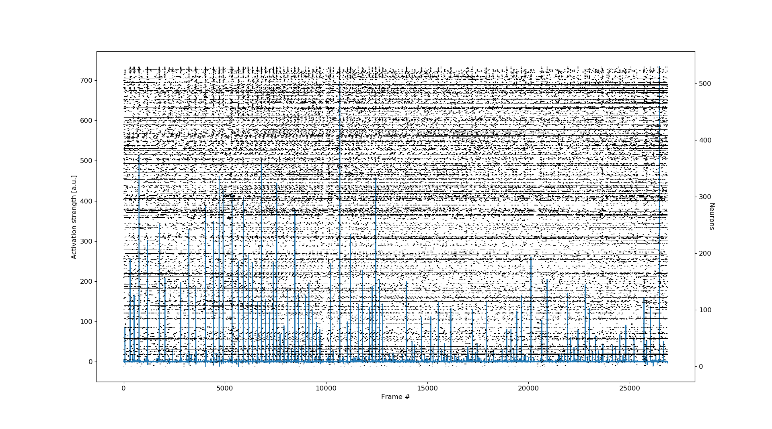
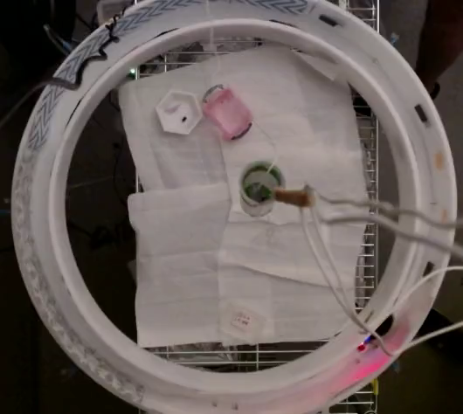
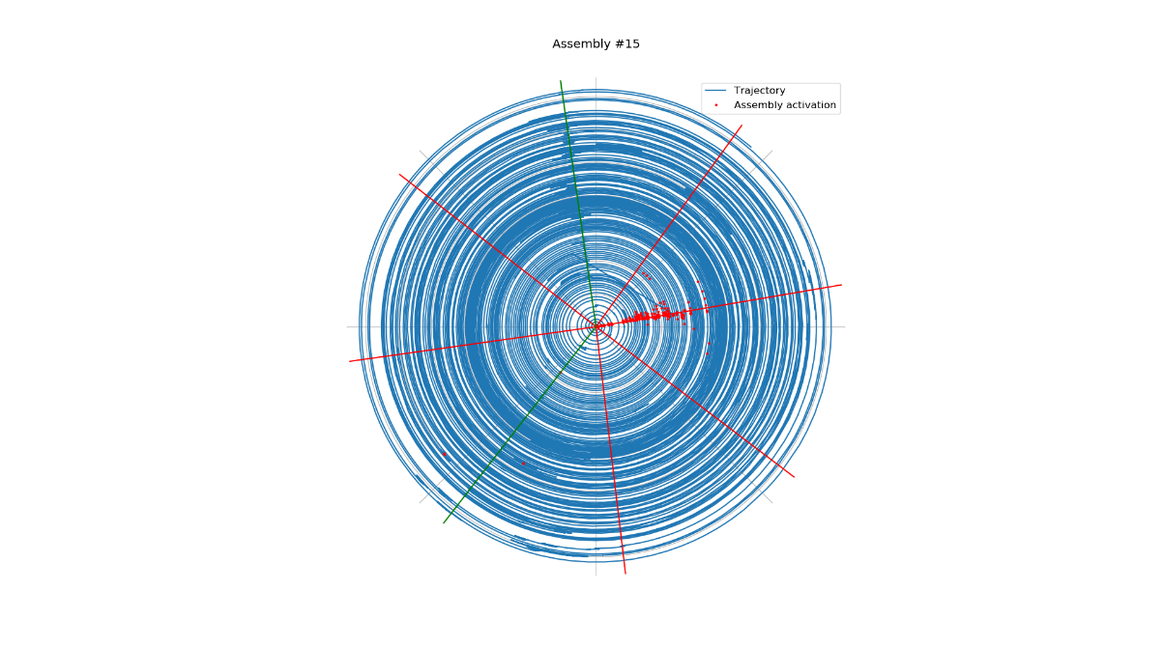
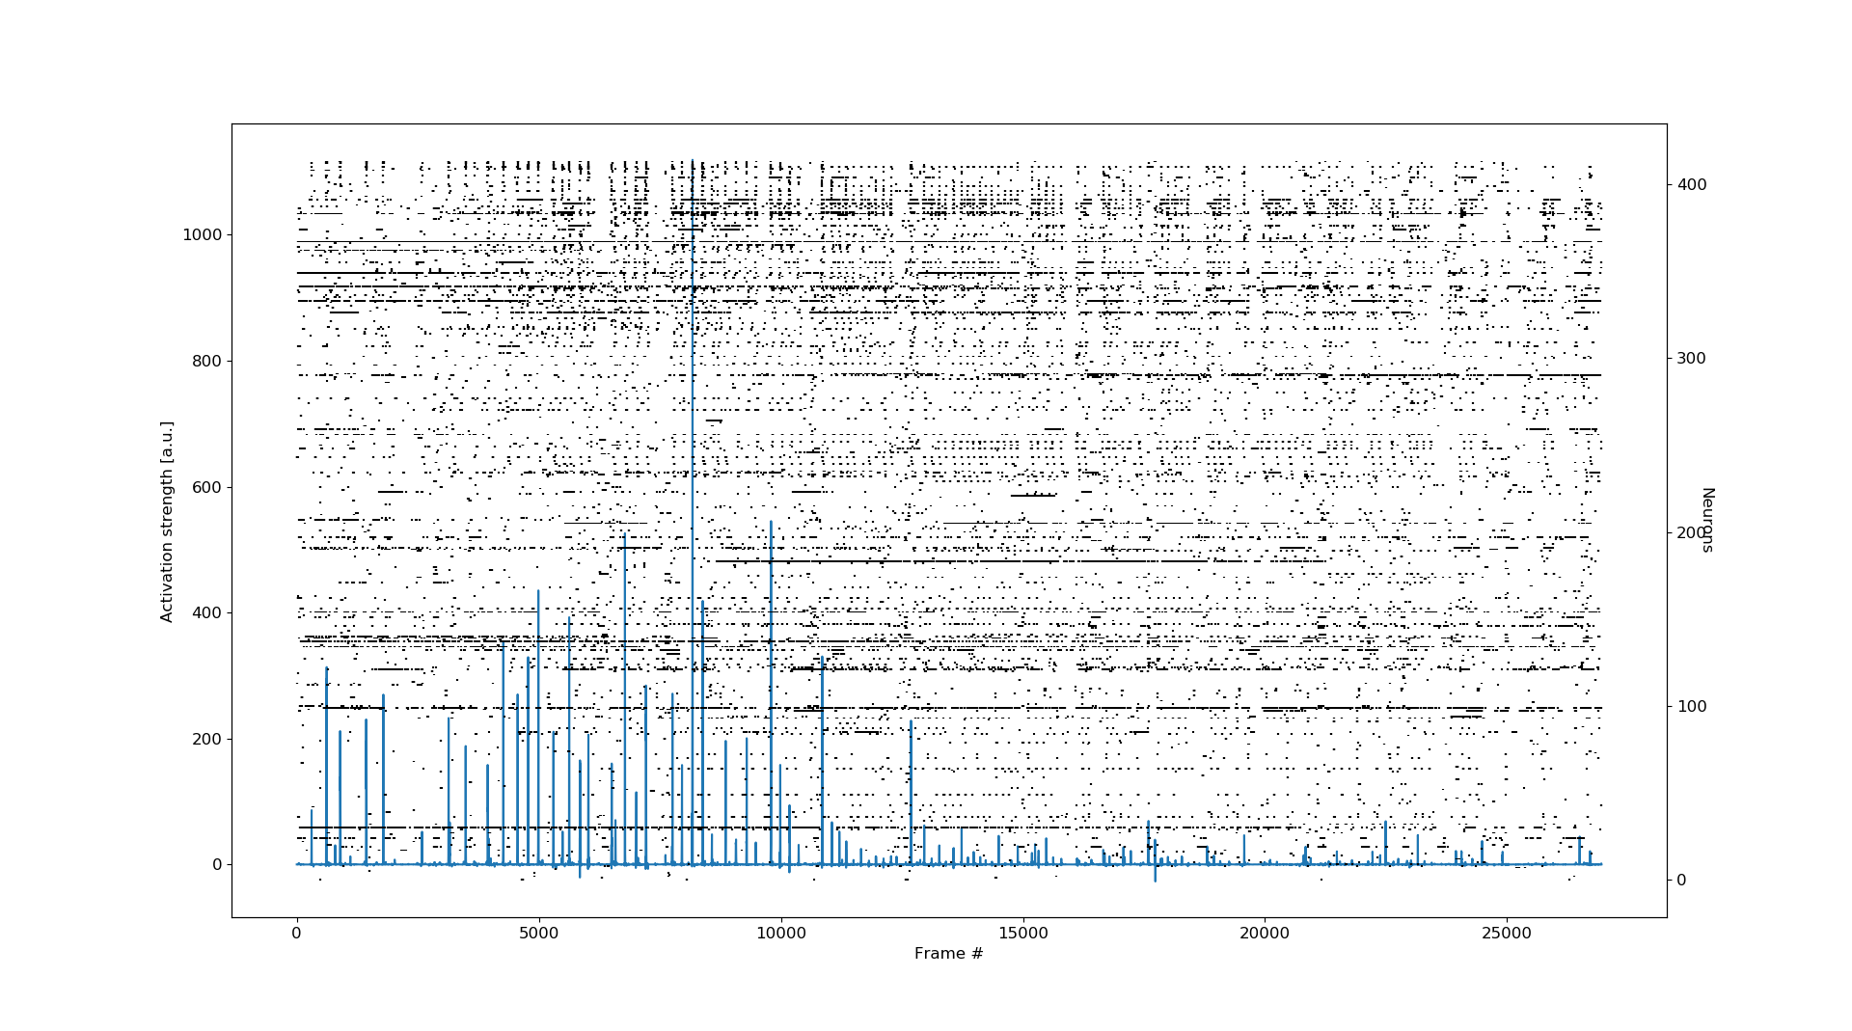
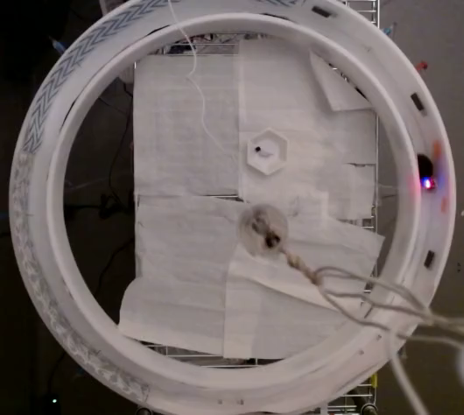
Example ensembles active during perseverative seeking

Slide 26
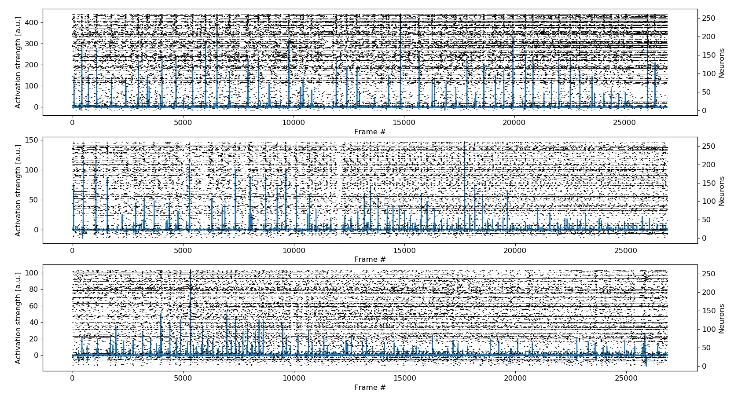
Starting to examine ensembles across days

Slide 27
To do
More analyses
3 young mice to record from
3 waiting to be base plated
1 aged mouse to record from
4 waiting to be base plated
dCA1 inhibition with PSAM during Reversal1
Neurogenesis/LTD knockdown

